Slide 1
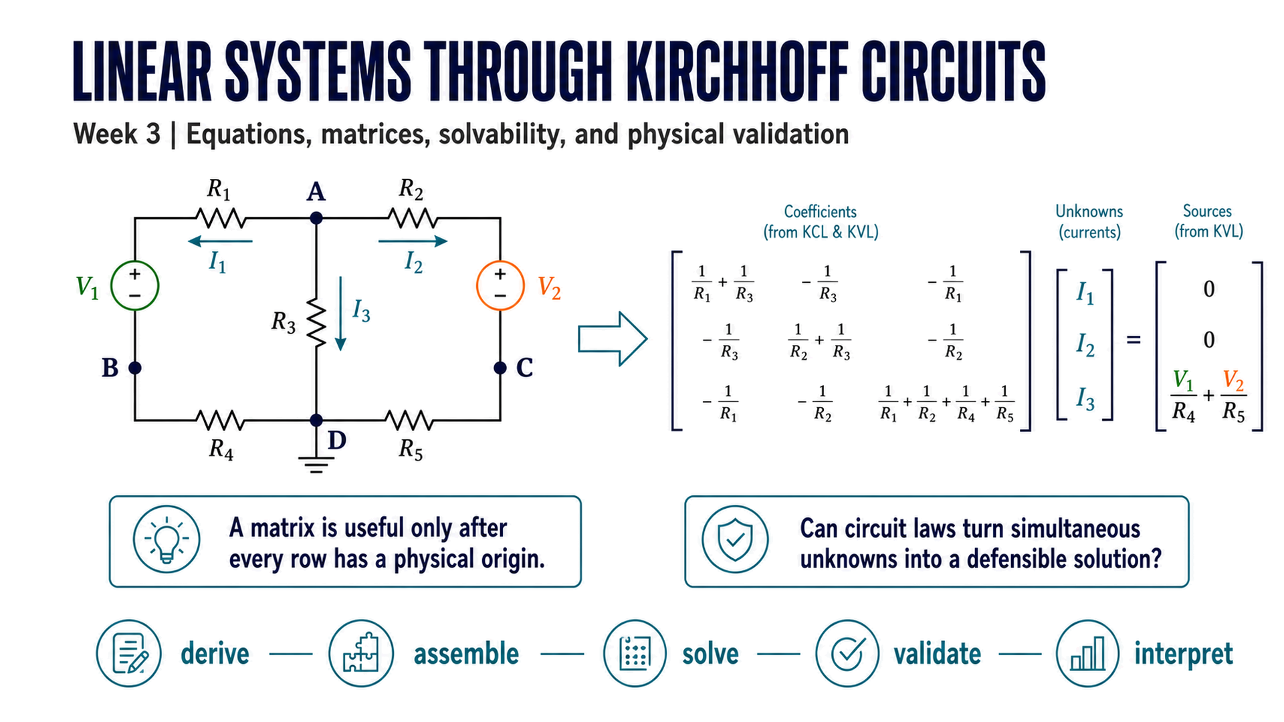
Notes:
Timing: 0–6 min Checkpoint/question: Ask what must be known before MATLAB can solve for an unknown circuit voltage. Transition: Position matrix solving as one stage in a longer physical argument.

Slide 2
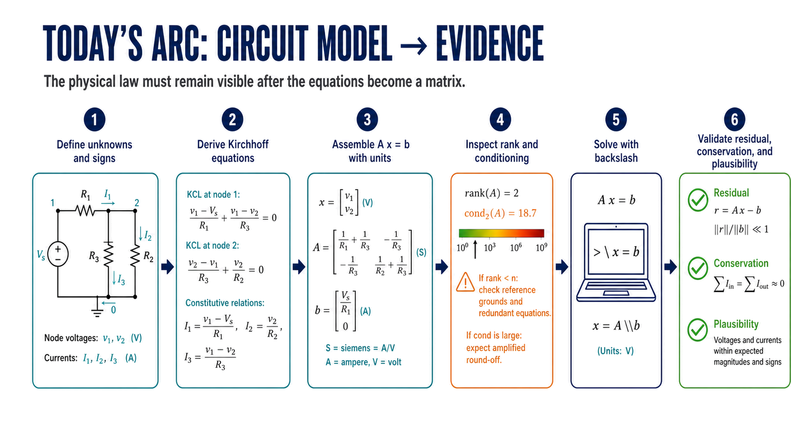
Notes:
Timing: 6–12 min Checkpoint/question: Which stage would be skipped if AI returned a matrix immediately from a circuit image? Transition: Connect linear systems to several physical settings before focusing on circuits.

Slide 3
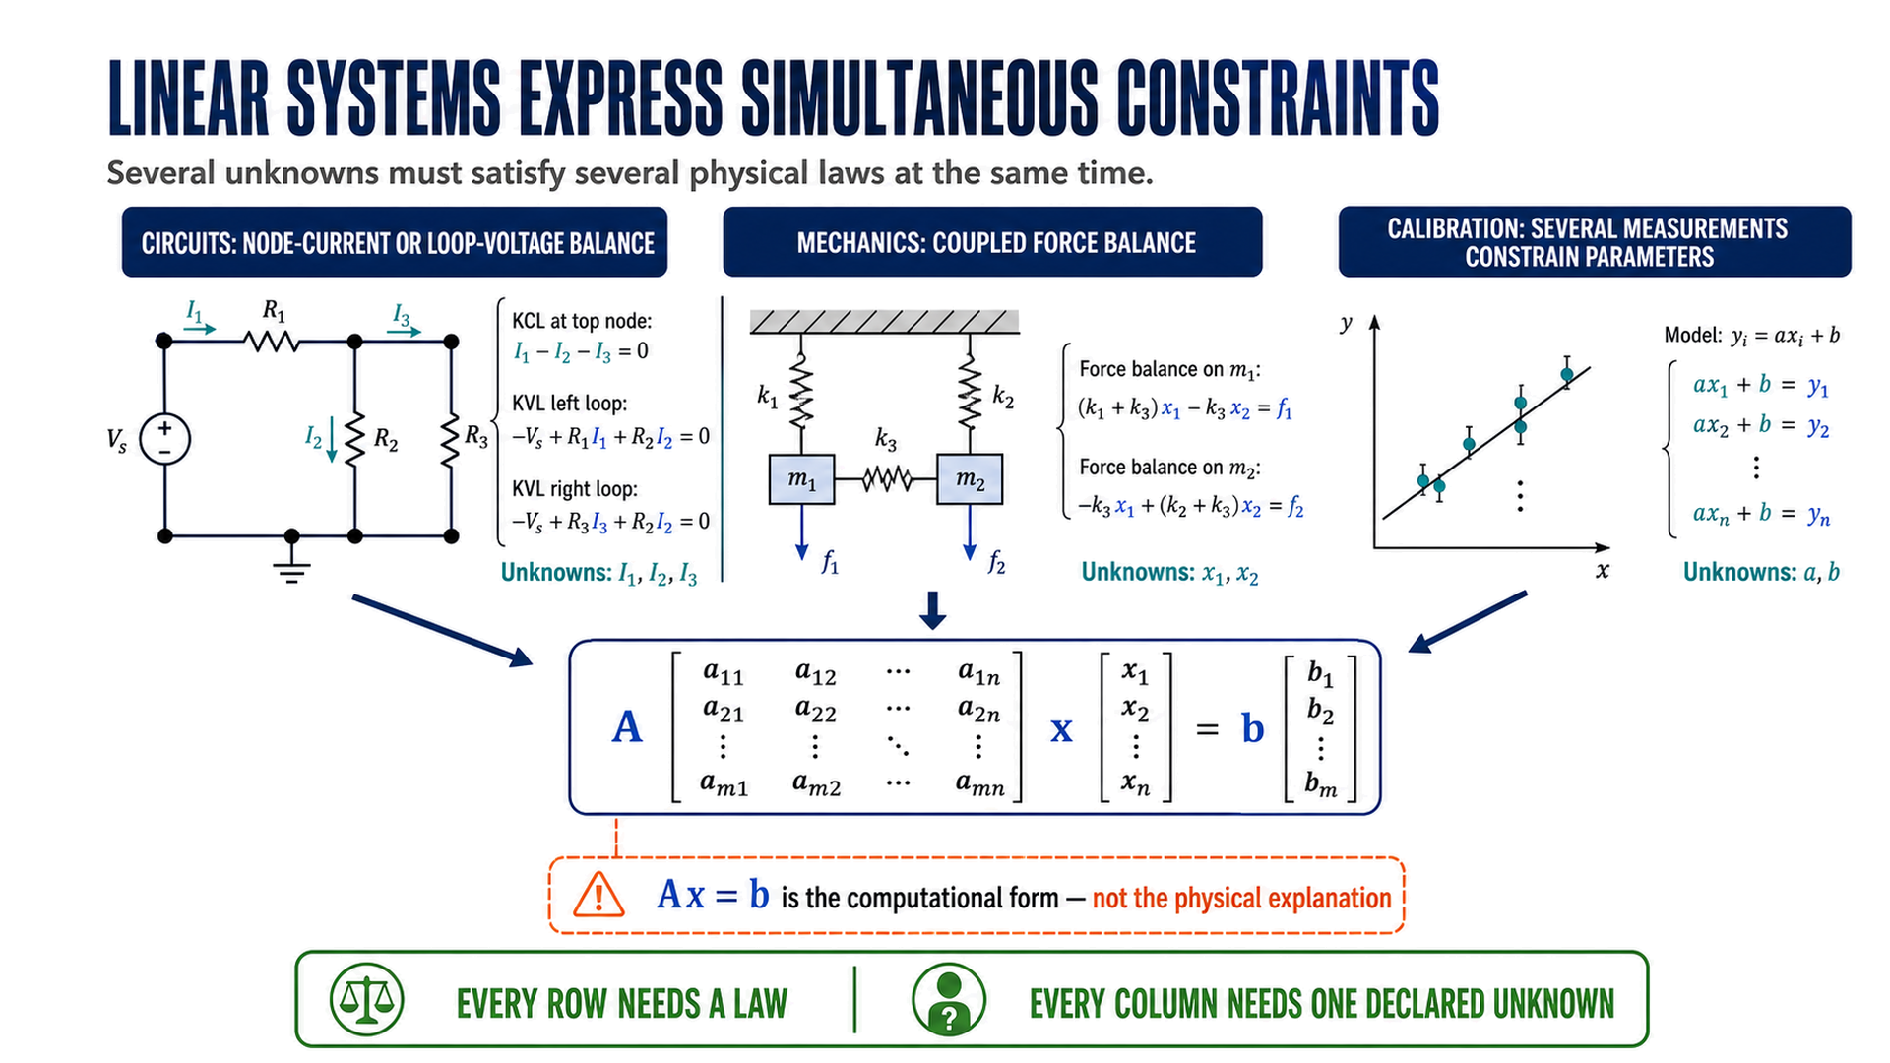
Notes:
Timing: 12–18 min Checkpoint/question: Ask students to name the law behind a matrix row in one non-circuit example. Transition: Introduce the two-node network and make predictions before equations.

Slide 4
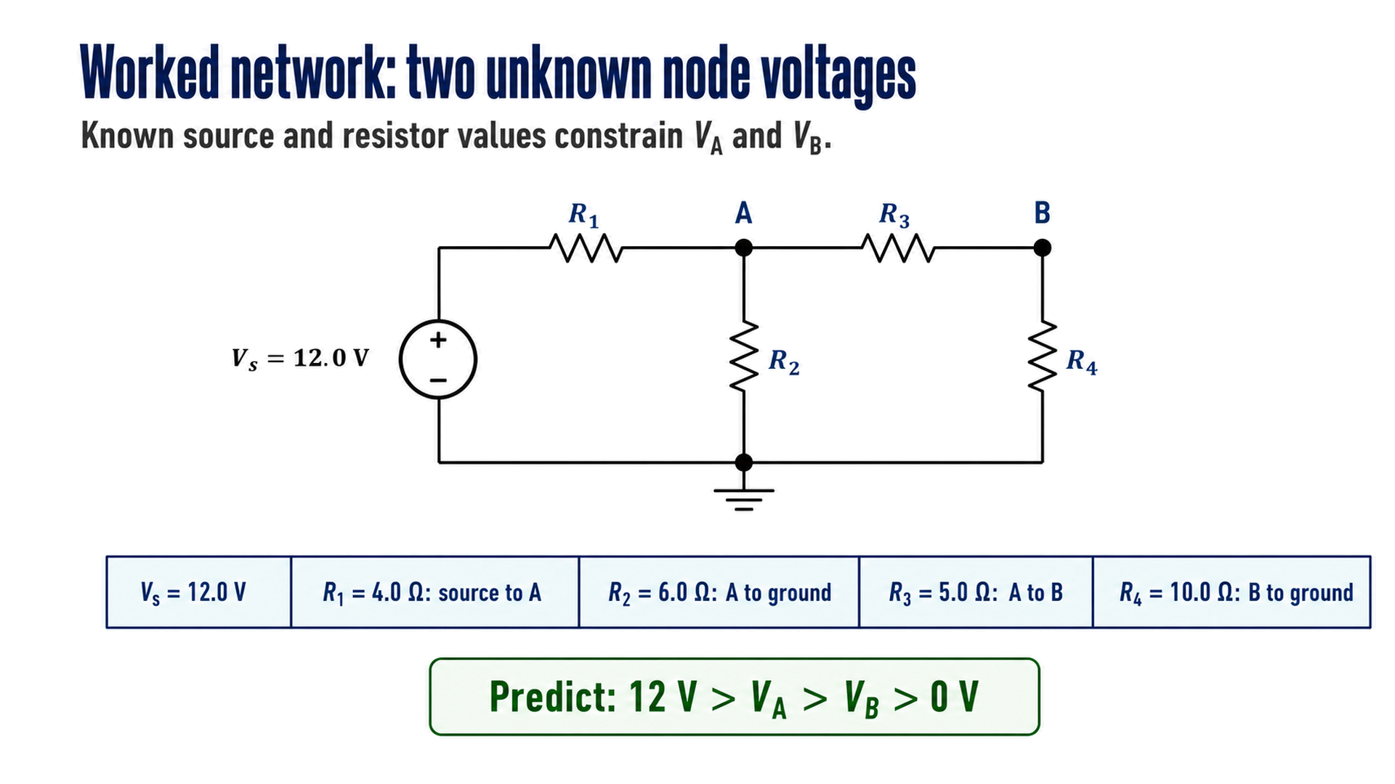
Notes:
Timing: 18–25 min Checkpoint/question: Predict every branch-current direction without calculating magnitudes. Transition: Lock the reference node, unknown vector, and current signs.

Slide 5
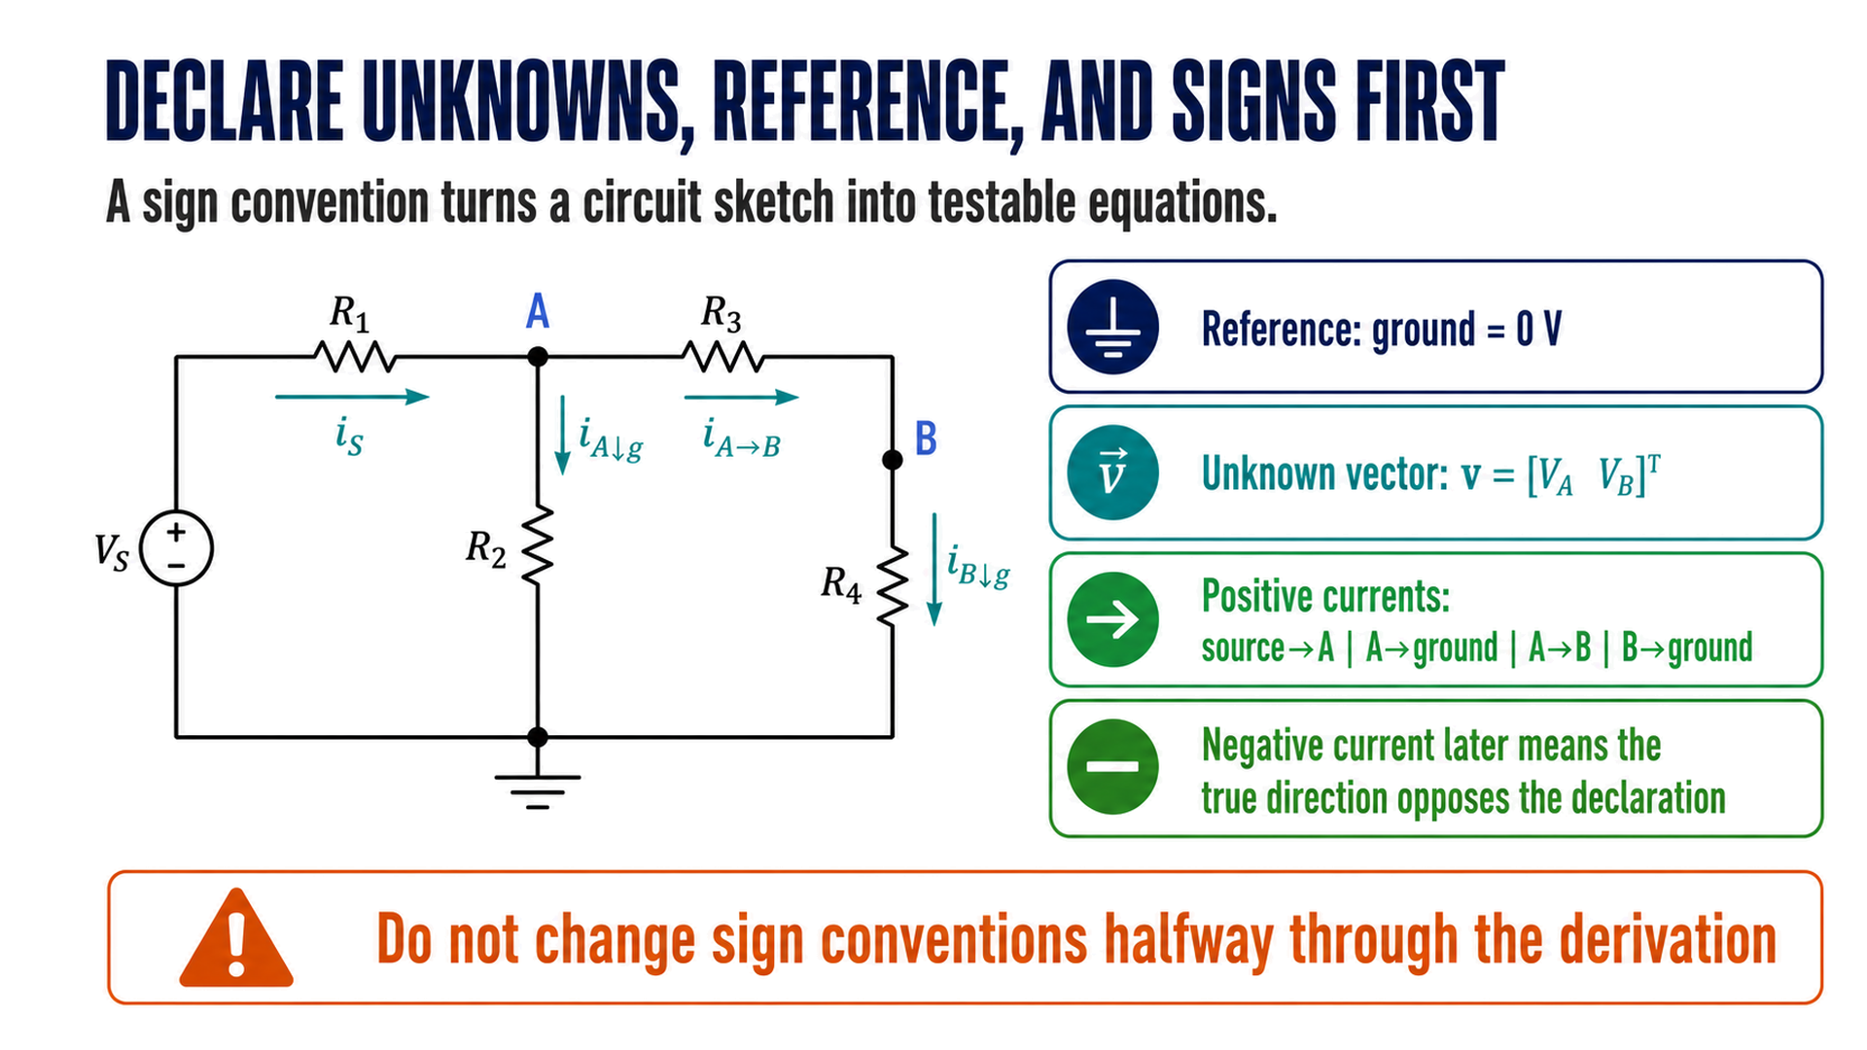
Notes:
Timing: 25–31 min Checkpoint/question: Ask whether a negative solution is automatically unphysical. Transition: Apply KCL to each unknown node before showing any matrix.

Slide 6
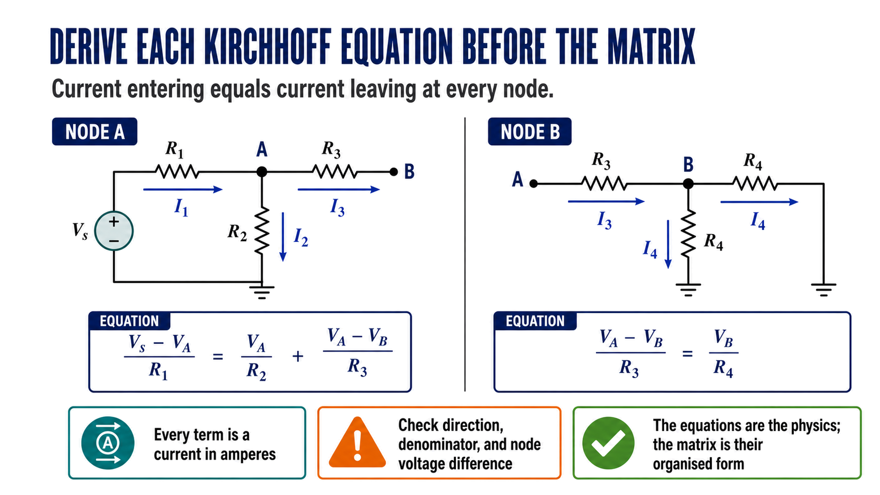
Notes:
Timing: 31–39 min Checkpoint/question: Have students explain why the R3 current appears in both equations with related signs. Transition: Rearrange coefficients by unknown while preserving units.

Slide 7
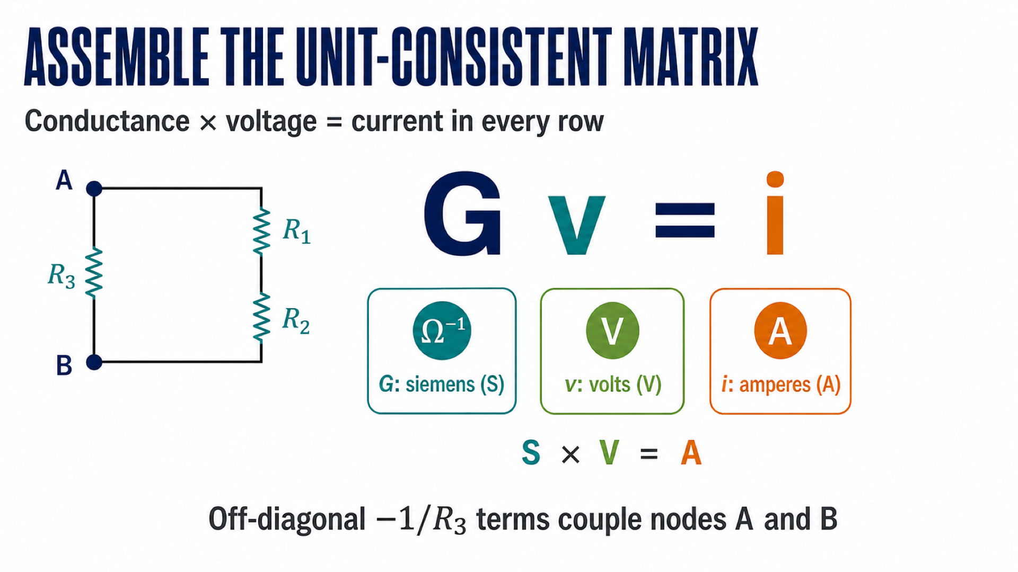
Notes:
Timing: 39–47 min Checkpoint/question: Ask students to map each matrix coefficient back to one current term. Transition: Inspect whether the assembled system has a unique and stable-enough solution.

Slide 8
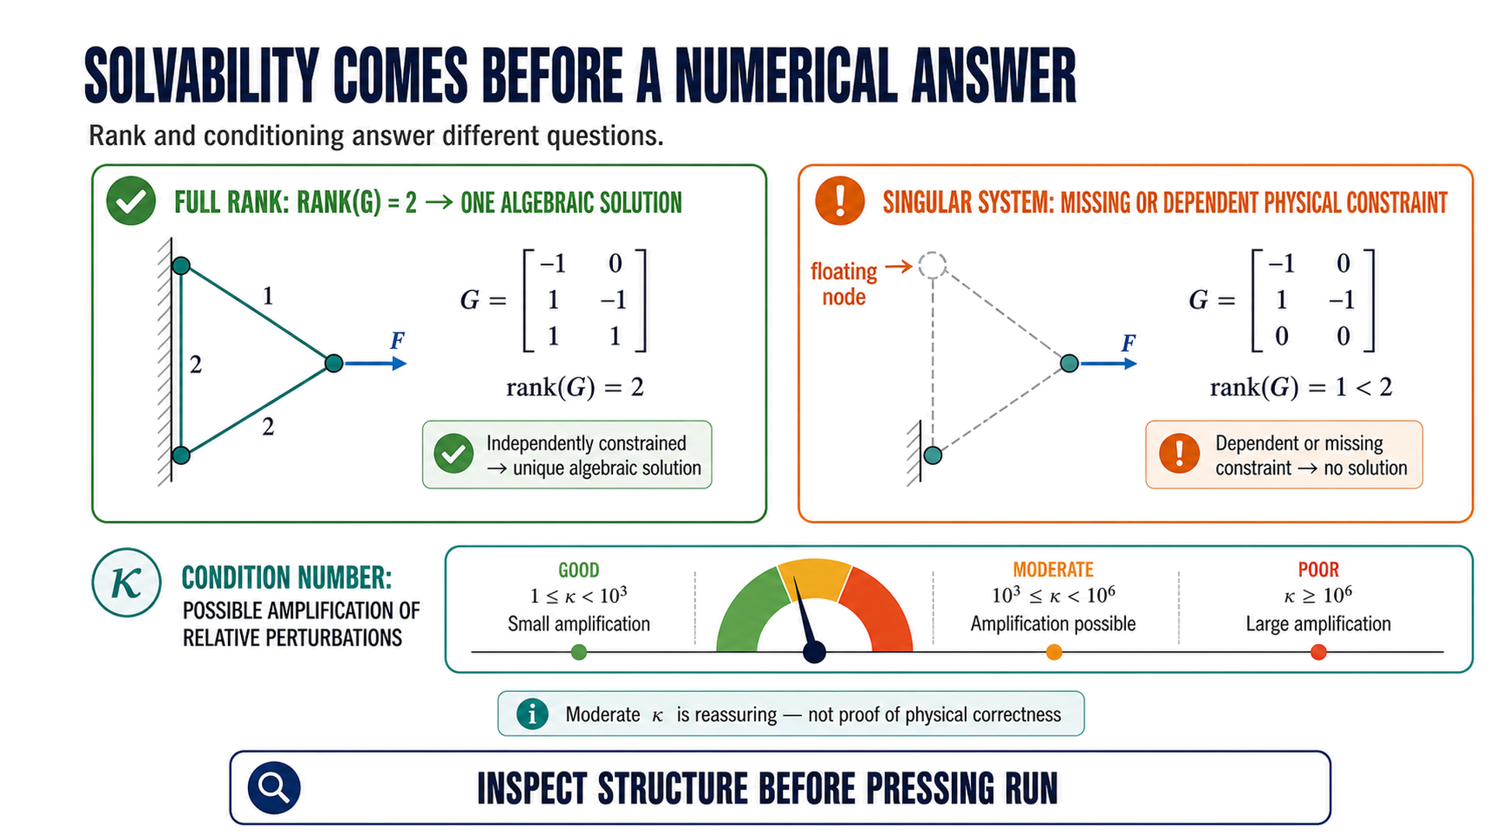
Notes:
Timing: 47–54 min Checkpoint/question: What circuit-modelling mistake could leave a node floating and make the system singular? Transition: Solve directly and avoid an unnecessary explicit inverse.

Slide 9
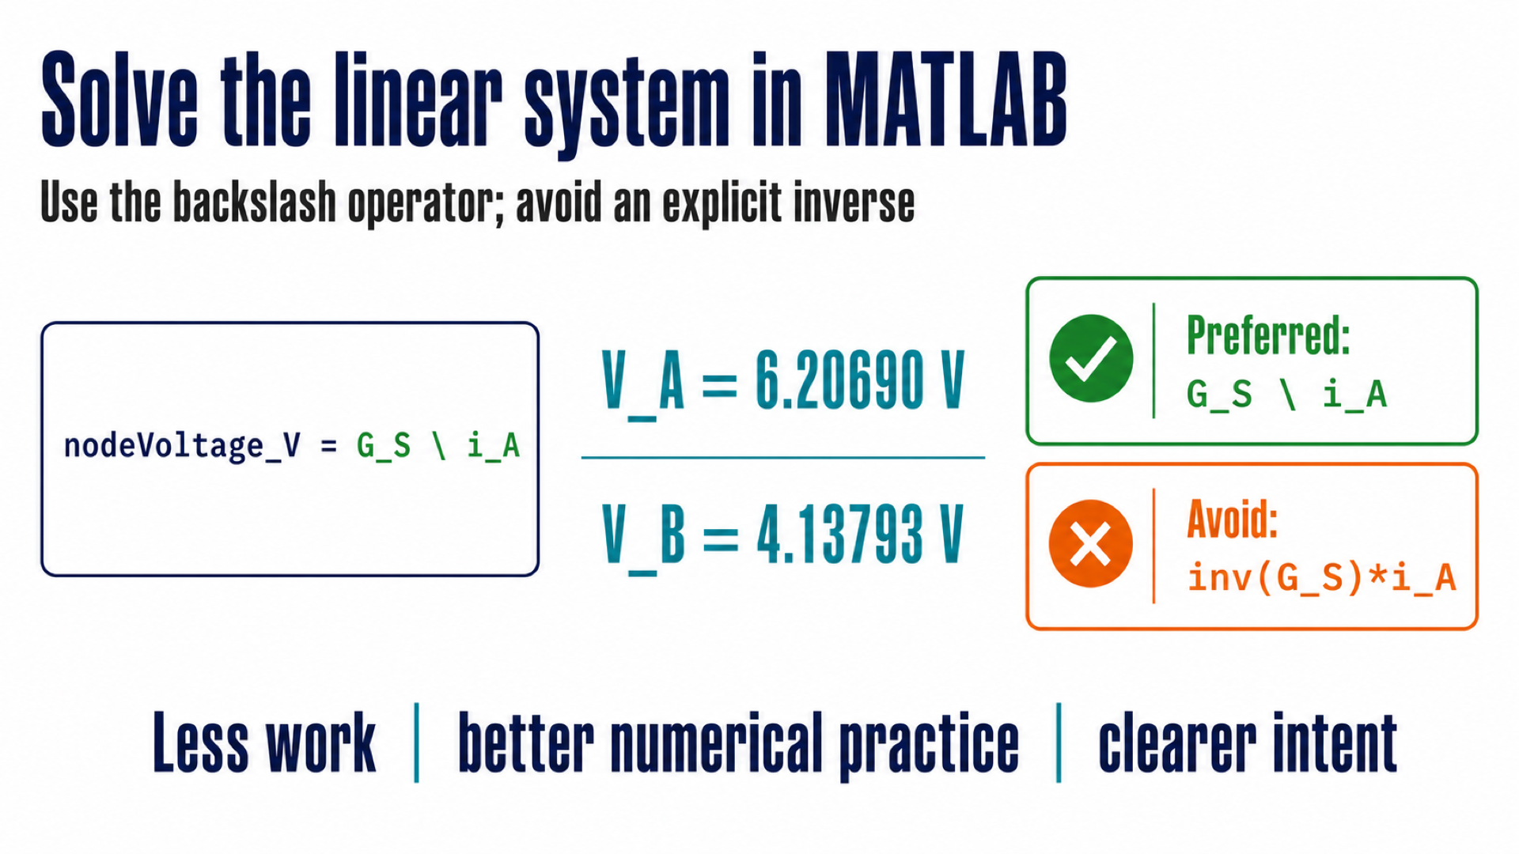
Notes:
Timing: 54–61 min Checkpoint/question: Compare the computed voltage ordering with the original prediction. Transition: Translate the two node voltages back into four branch currents.

Slide 10
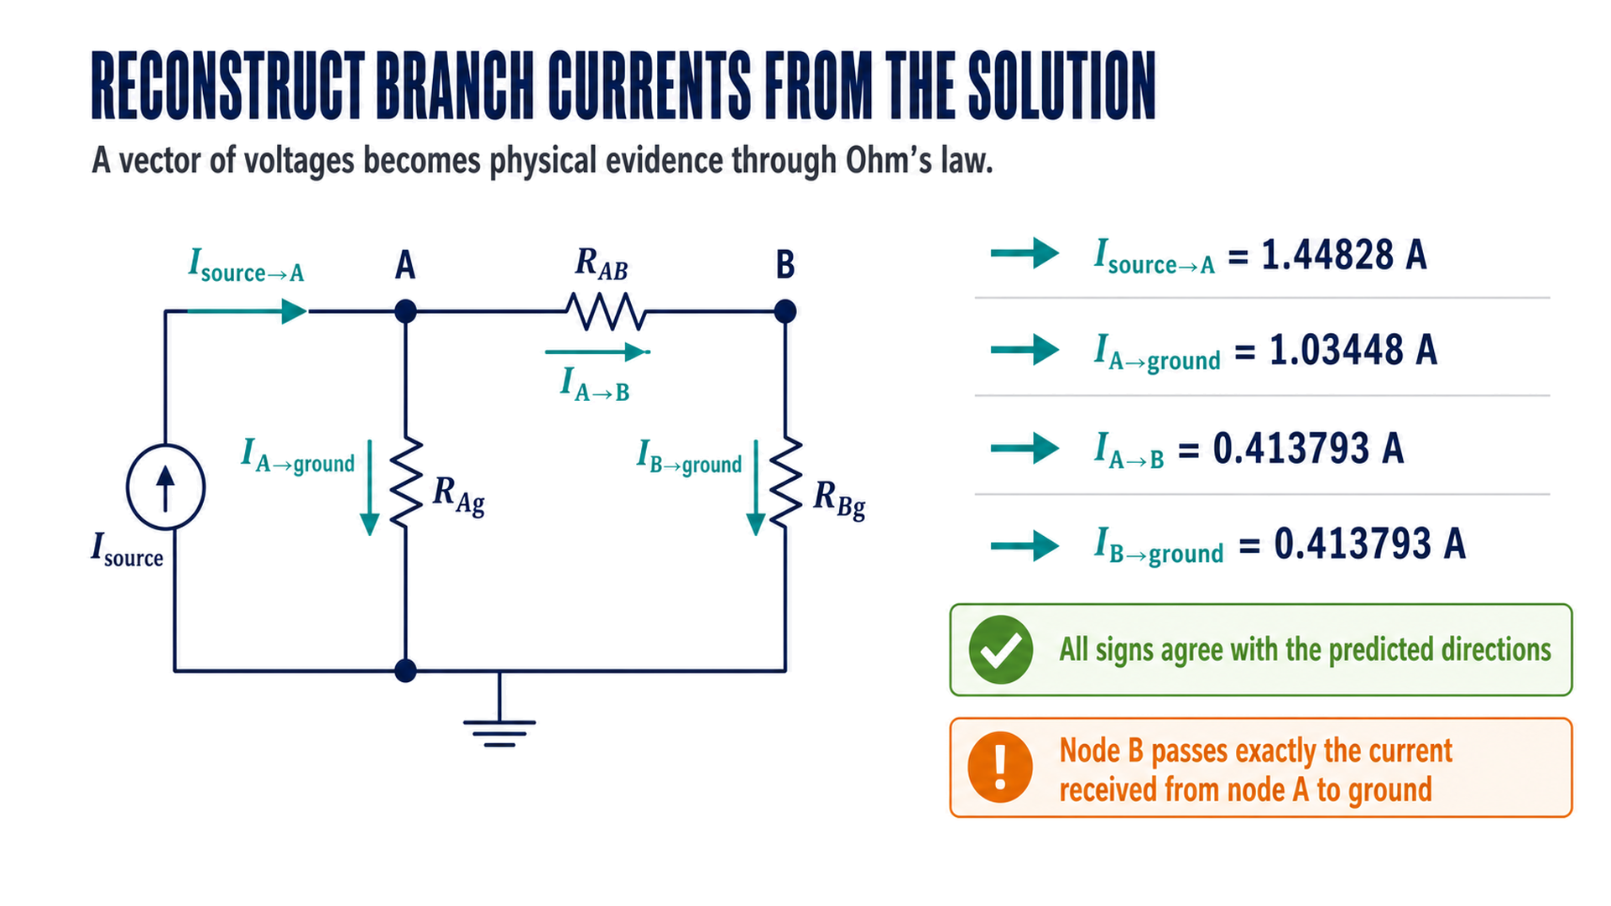
Notes:
Timing: 61–68 min Checkpoint/question: Ask which two currents must match at node B and why. Transition: Separate algebraic residual evidence from physical validation.

Slide 11
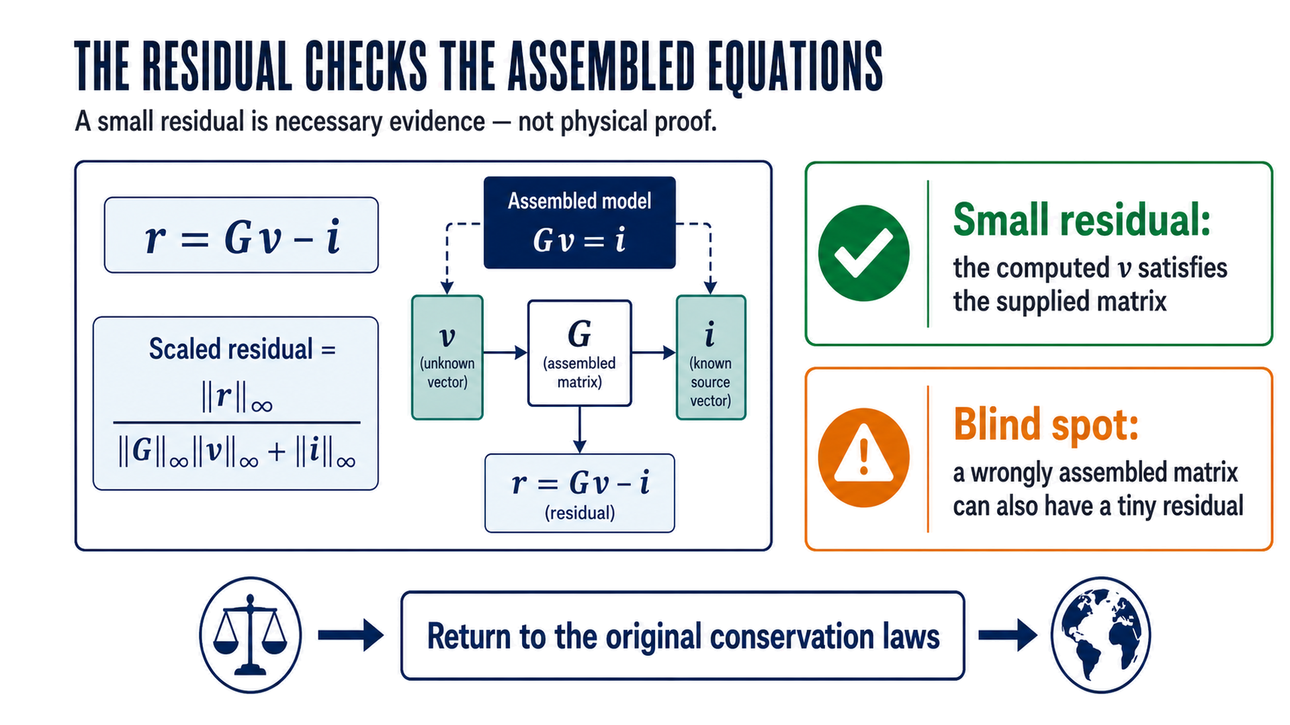
Notes:
Timing: 68–75 min Checkpoint/question: Ask for one wrong matrix that MATLAB could solve accurately. Transition: Reconstruct KCL directly from branch currents.

Slide 12
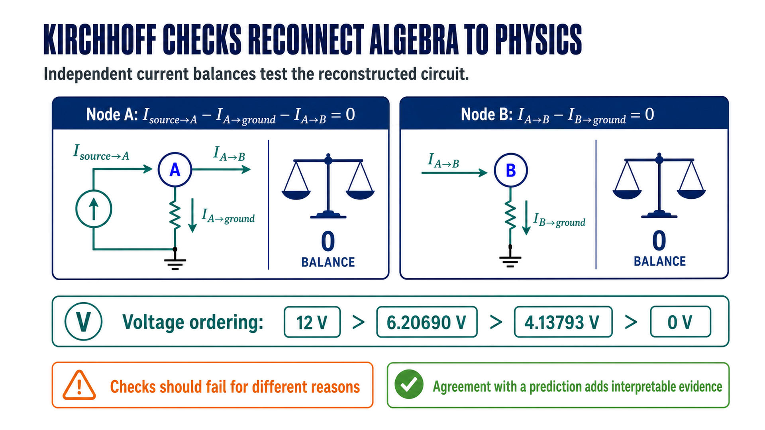
Notes:
Timing: 75–82 min Checkpoint/question: Ask what a sign error in the R3 term would do to each node balance. Transition: Add a whole-network energy-rate check through power.

Slide 13
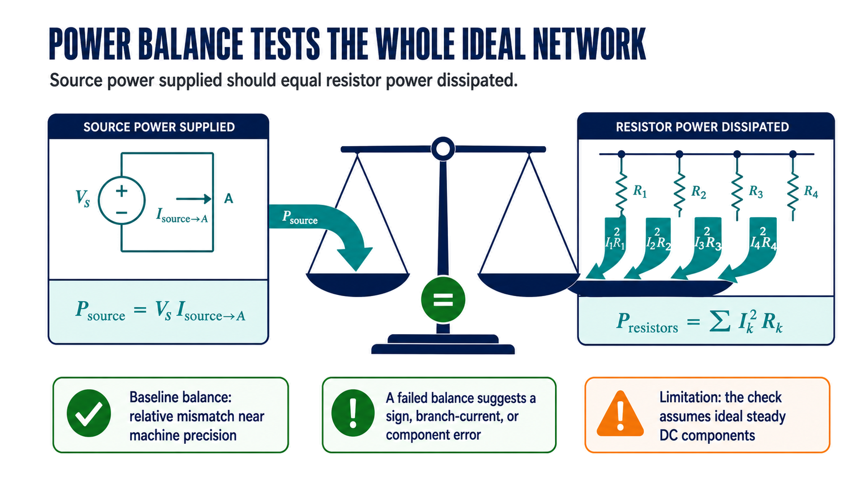
Notes:
Timing: 82–89 min Checkpoint/question: Why are resistor powers non-negative even when a declared current is negative? Transition: Contrast residual size with sensitivity to changed component values.

Slide 14
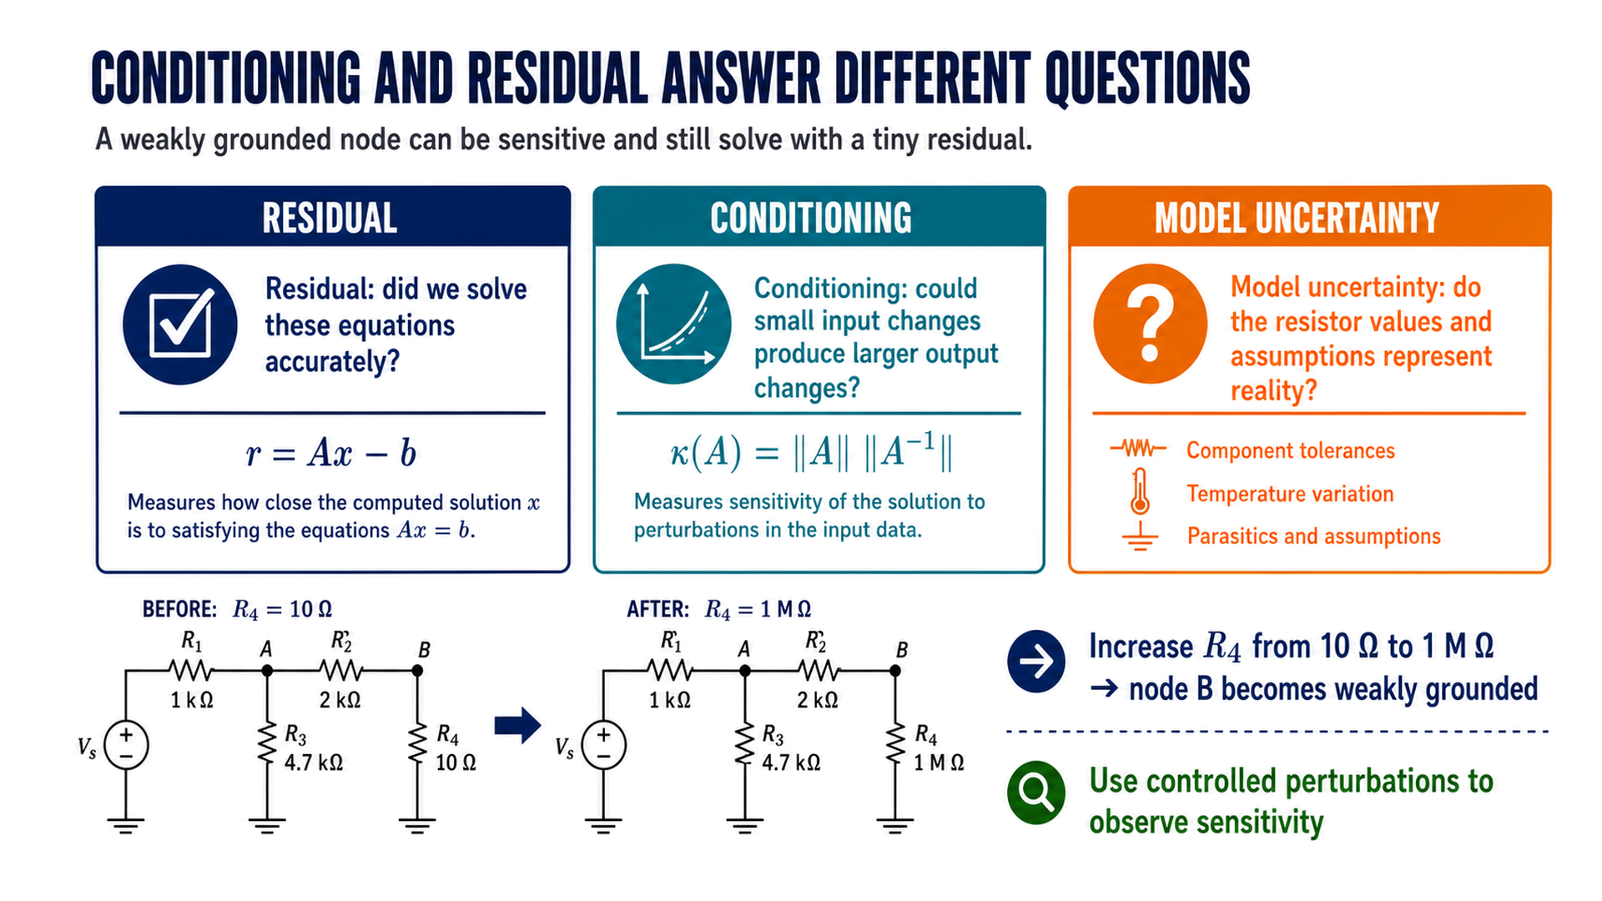
Notes:
Timing: 89–96 min Checkpoint/question: Ask whether condition number can be reported as the actual percentage error. Transition: Show a compact failure catalogue and the check that exposes each defect.

Slide 15
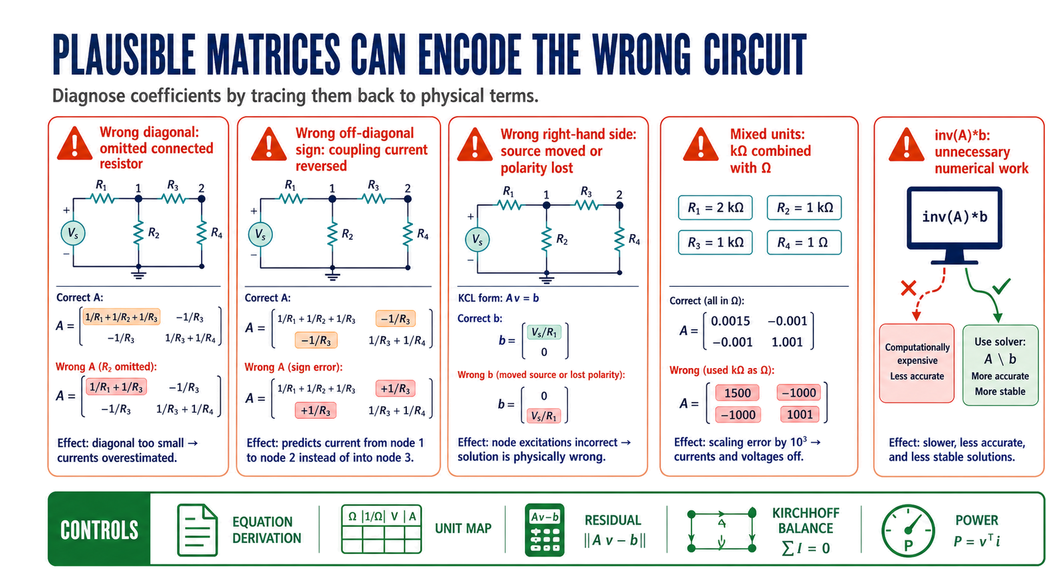
Notes:
Timing: 96–103 min Checkpoint/question: Give one defective coefficient and ask which independent test would expose it first. Transition: Transfer the same reasoning to mesh currents in the practical.

Slide 16
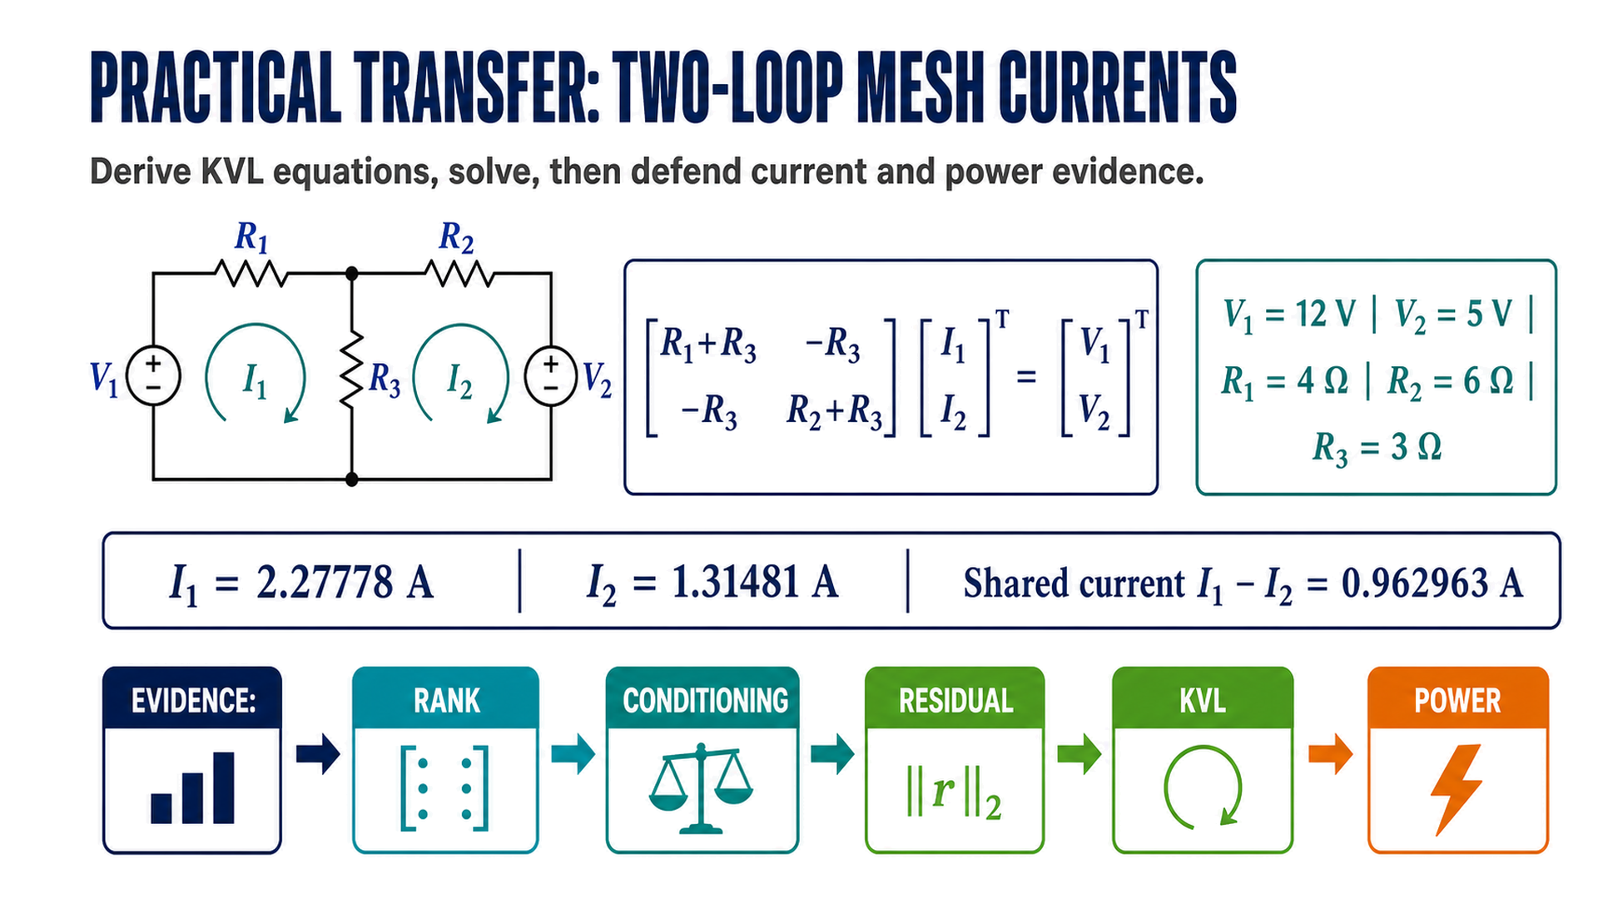
Notes:
Timing: 103–109 min Checkpoint/question: Predict which mesh current is larger before showing the reference values. Transition: Open bounded capstone problem spaces without forcing an early topic choice.

Slide 17
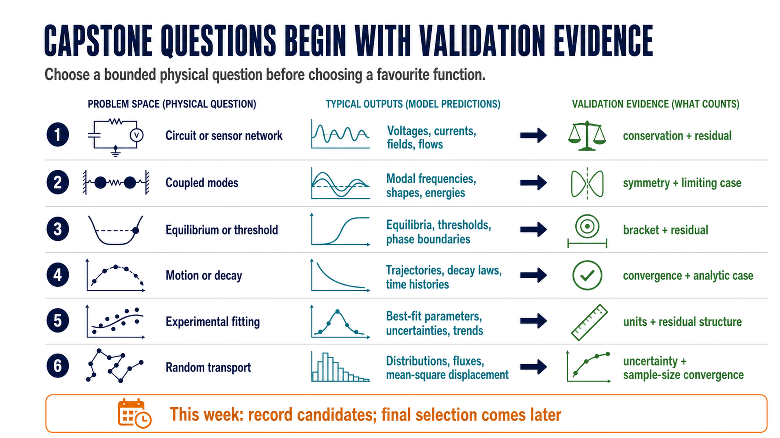
Notes:
Timing: 109–115 min Checkpoint/question: Ask each group for one observable output and one independent check for a candidate space. Transition: Close by reconnecting the matrix solve to the complete computational-physics chain.

Slide 18
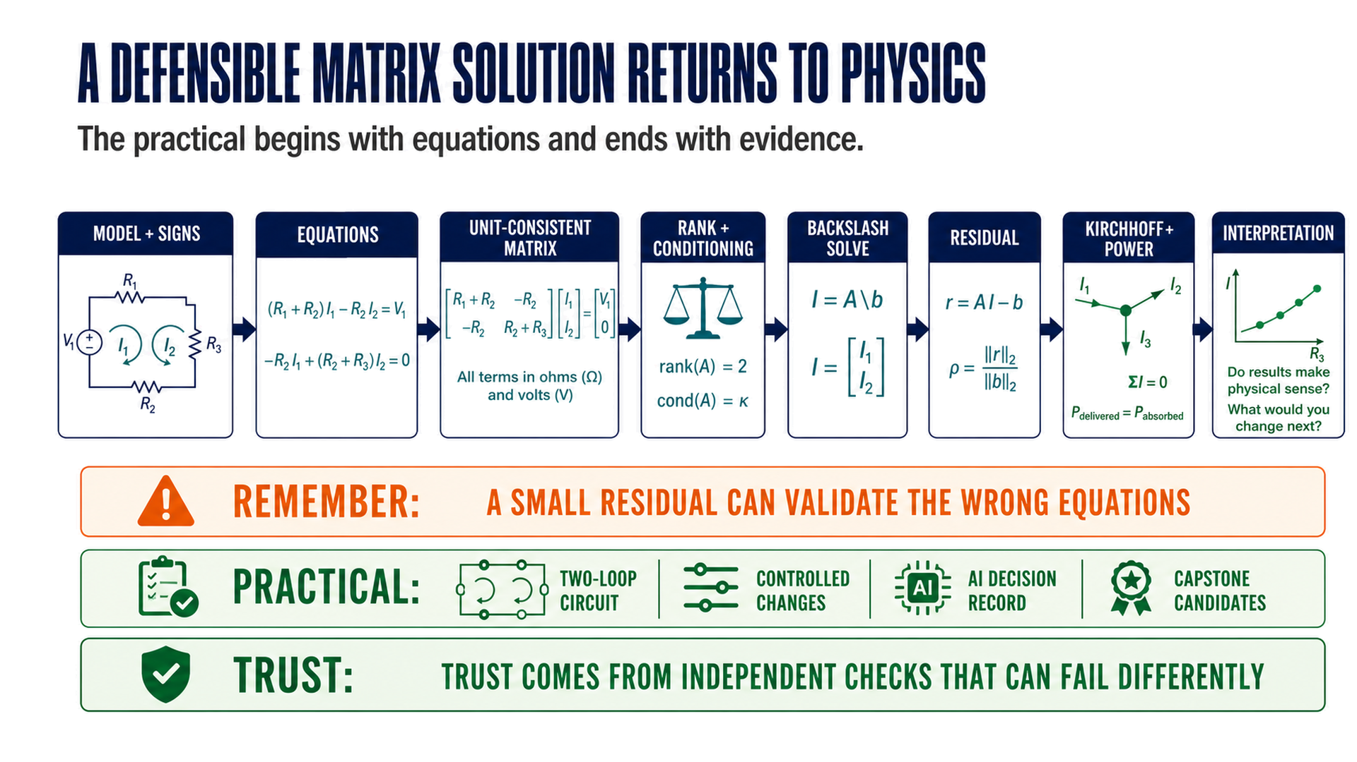
Notes:
Timing: 115–120 min Checkpoint/question: Exit prompt: name one algebraic check and one physical check, and explain the difference. Transition: Direct students to the Week 03 individual check before group practical work.

